Slide 1
Equation Solver
Triangular Factorisation Methods [LU]

Slide 2
Objectives:
Introduction of Numeric Methods.
Define Triangular Factorization Methods.
Define LU Methods.
Project Description.

Slide 3
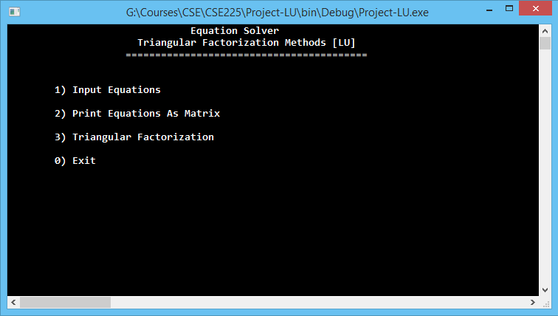
Project Ideas and Layouts
Using Interface – (windows console)

Slide 4
Project Ideas and Layouts
1) Input Equations
Input Equations.
2) Print Equations As Matrix
Print Equations as matrix.
Return to main menu.
3) Triangular Factorization
1) Print Upper Matrix
2) Print Lower Matrix
3) Calculate Solution
0) Return To Main Menu
0) Exit
Print the upper triangle matrix.
Print the lower triangle matrix.
Print the solutions.
Terminate Program.

Slide 5
Algorithm Descriptions:
Triangular Factorisation Methods
Using Dolittle LU Decomposition

Slide 6

Algorithm Descriptions:
Input n, a, b
Set u_{1j} = a_{1j} => for j=1 to n
Set l_{ii} = 1 => for i=1 to n
Set l_{i1} = a_{i1} / u₁₁ => for i=2 to n
For each j=2 to n do:
For i=2 to j
Compute u_{ii} = a_{ij} - $\sum_{k=1}^{j−1}{l\text{i}k } u\text{kj}$
ii) For i=j + 1 to n
Compute l_{ii} = $\frac{1}{u\text{ij}}$ × $\text{[} \text{a}\text{ij} \text{−}\sum_{k=1}^{j−1}{l\text{i}k } u\text{kj} ]$
Set z₁ = b₁
For i=2 to n
Set sum = $\sum_{j=1}^{j−1}{l\text{i}j } \text{z}\text{j}$
Set z_{i} = b_{i} - sum

Slide 7

Algorithm Descriptions:
Set x_{n} = z_{n} / u_{nn}
For i=n-1 to 1
sum = $\sum_{j=i+1}^{n}{u\text{i}j } \text{x}\text{j}$
Set x_{i} = (z_{i} - sum) / u_{ii}
8. Write results.

Slide 8
Thank You.

